Slide 1

SKOPE VR 1.0
By Parker Scott and Jose Maldonado
pscot012@fiu.edu jmald045@fiu.edu

Slide 2
Why the name change?
You may see our group project as Learning with Augmented Reality, but its appropriate title is SKOPE VR:
Previous Versions were convoluted
Start the SKOPE with a clean slate
Begin Development on VR portion of SKOPE

Slide 3
The problem or challenge
Research shows that Virtual Reality (VR) mediated learning can improve the learning experience for students, however current VR system design approaches are unintuitive for students. Furthermore, the current systems don’t facilitate the addition of new experiences.

Slide 4
The Solution
We present an intuitive VR design approach geared towards immersed learning. Our primary focus lies on User Interface, Open World Design and Experiences. We also placed emphasis in implementing the ability to add experiences to the system at ease.

Slide 5
Current System
Version 1.0
SKOPE VR utilizes the Oculus Rift to interact with the environment
Full Scale Model of SIPA
Experiences within simulation for educational purposes and interactivity
Interactive UI

Slide 6
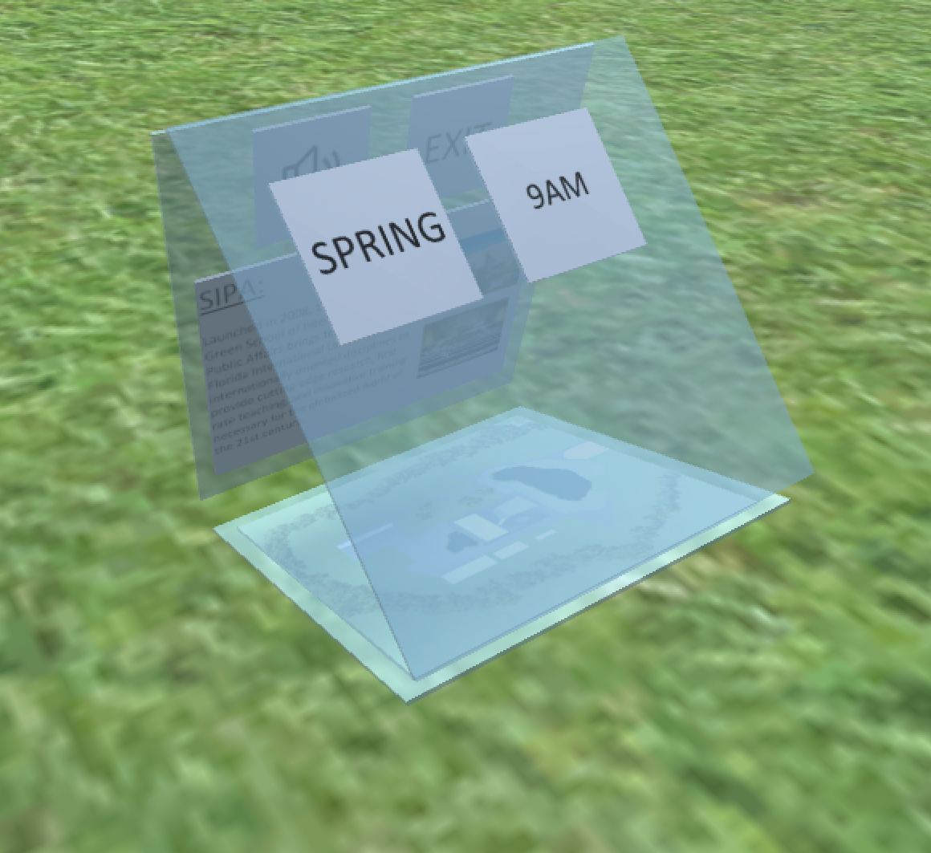
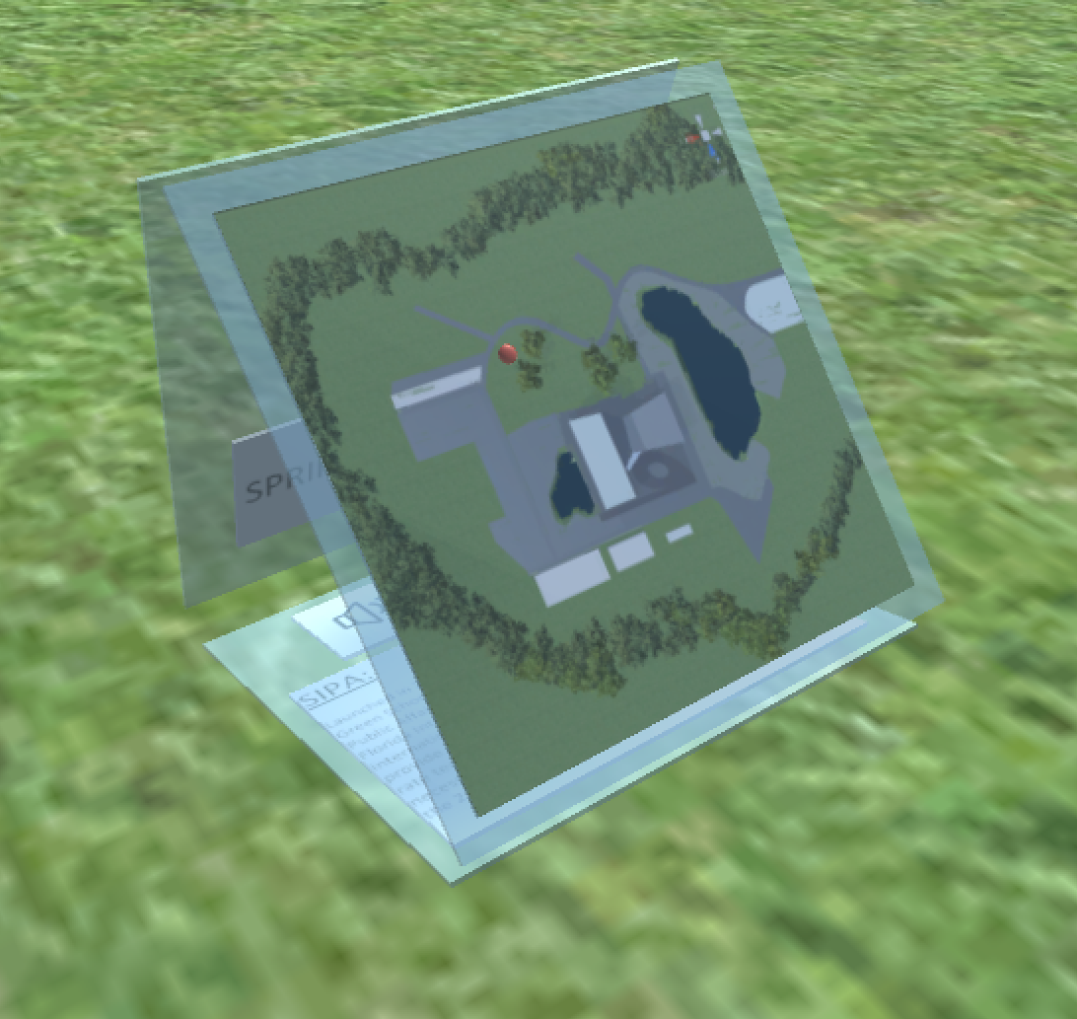
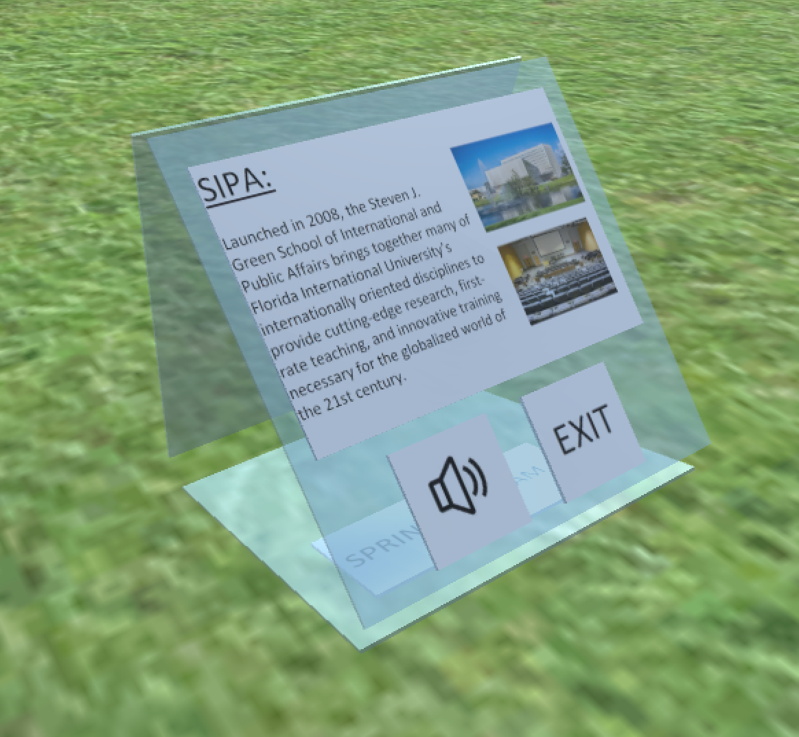
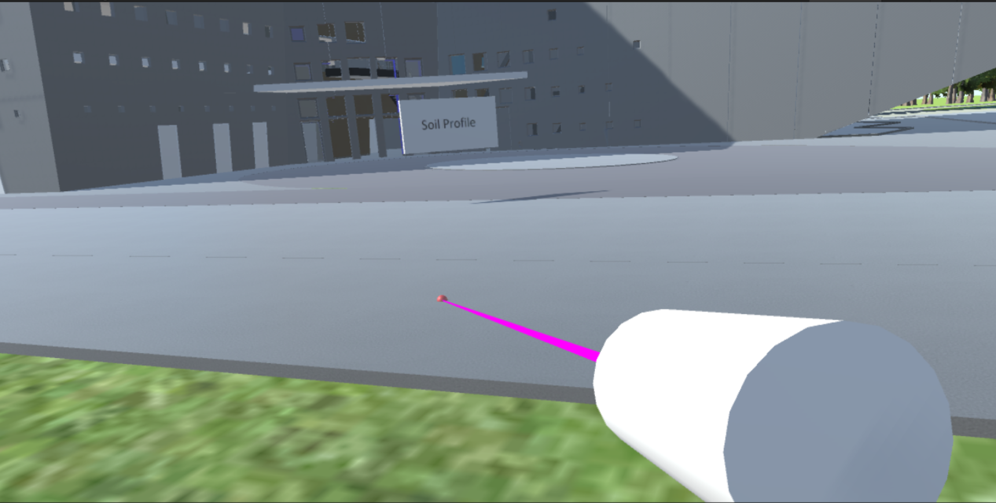
UI Screenshots
15

Slide 7
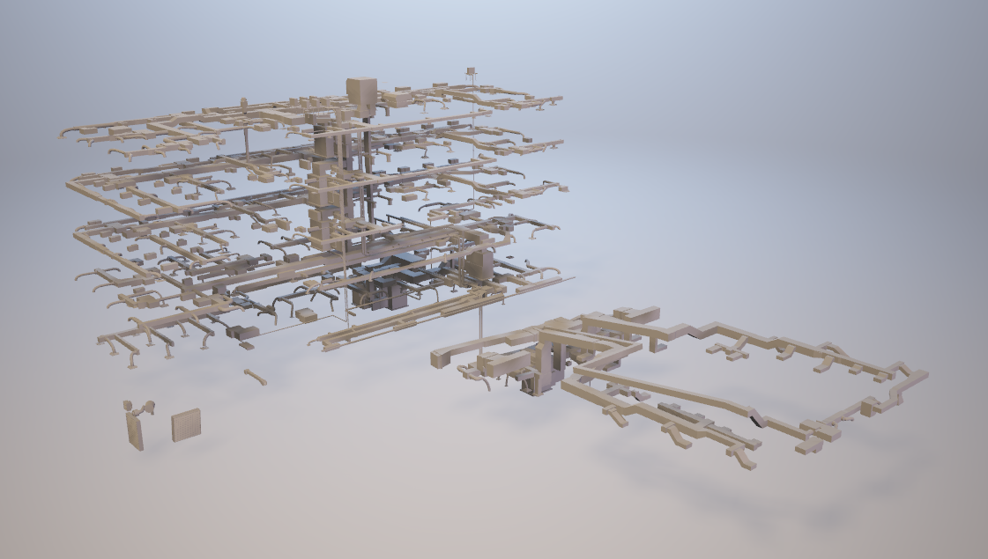
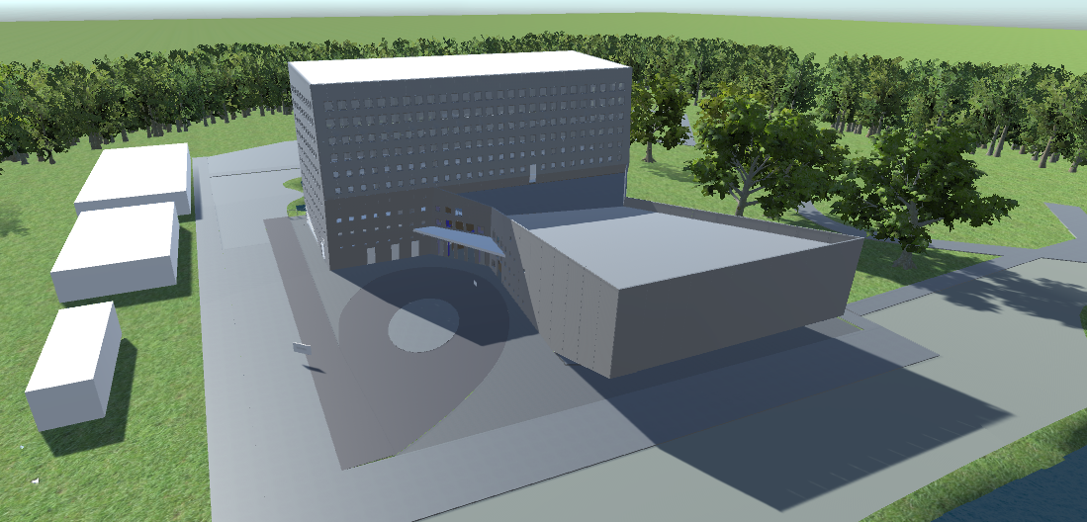
Experience Screenshots
15

Slide 8
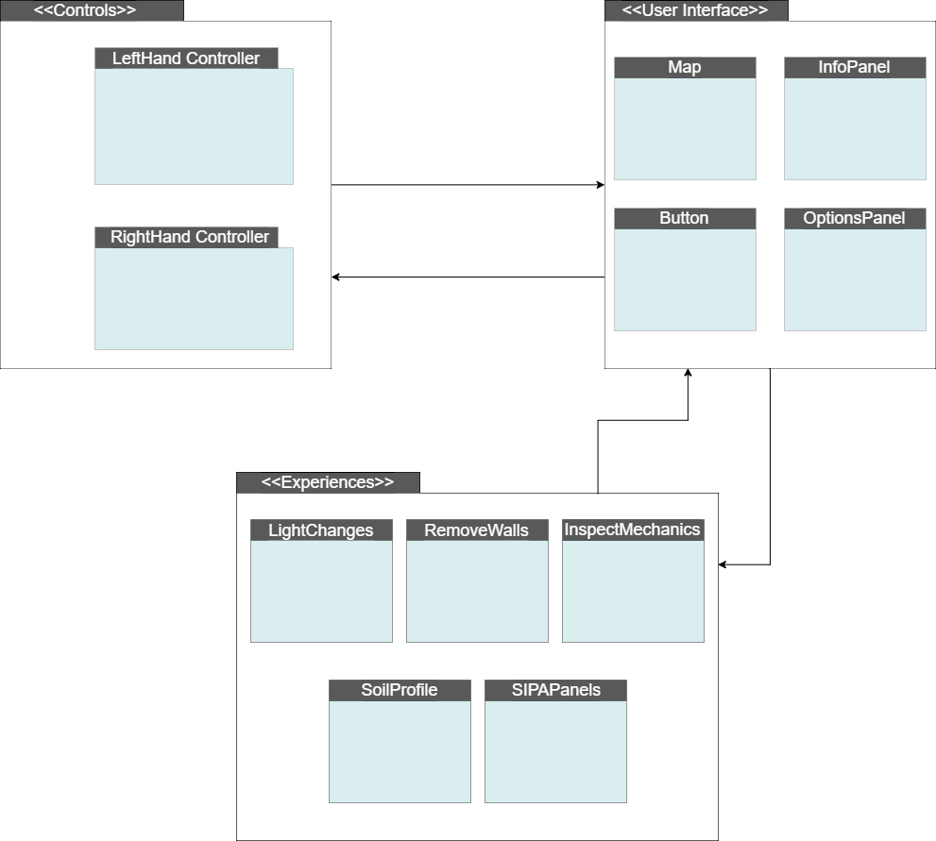
System Design

Slide 9
Our system was implemented using Unity 3D, Oculus SDK and Visual Studio 2017 running on Windows 10.

Slide 10
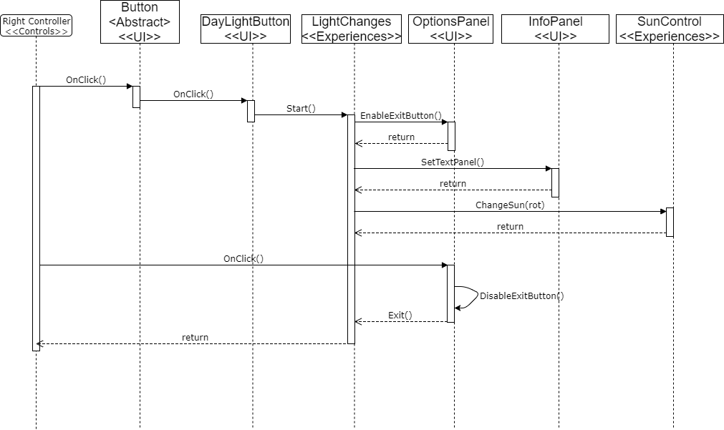
Sample Sequence
Diagram

Slide 11
Special Thanks
The material presented in this presentation is based upon the work done by Albert Elias and Prof. Shahin Vassigh in the SKOPE Project.

